Slide 1



INTERNSHIP AT ALTEN
R&D : Urgency in the Digital Twin Smart Green Supply Chain
Measuring declared against real urgency in a supply chain digital twin, so that it can be acted upon
HOARAU John
Cohort 2026 DED
COMPANY
PERIOD
TUTORS
ALTEN Sud-Ouest
13 April → 16 October 2026
S. Perthuisot and F. Jules, ALTEN
Direction de l’Innovation · Lab de Toulouse
Confidential: YES
Dr. D. Gomez, ESTIA · Dr. P. Sherar, Cranfield

Slide 2







PLAN
1
CONTEXT, PROBLEM, MISSION
2
HOW THE PROJECT WAS RUN
3
DESIGN AND REALISATION
4
RESULTS AND VALIDATION
5
ASSESSMENT AND PERSPECTIVES
2 | 20

Slide 3




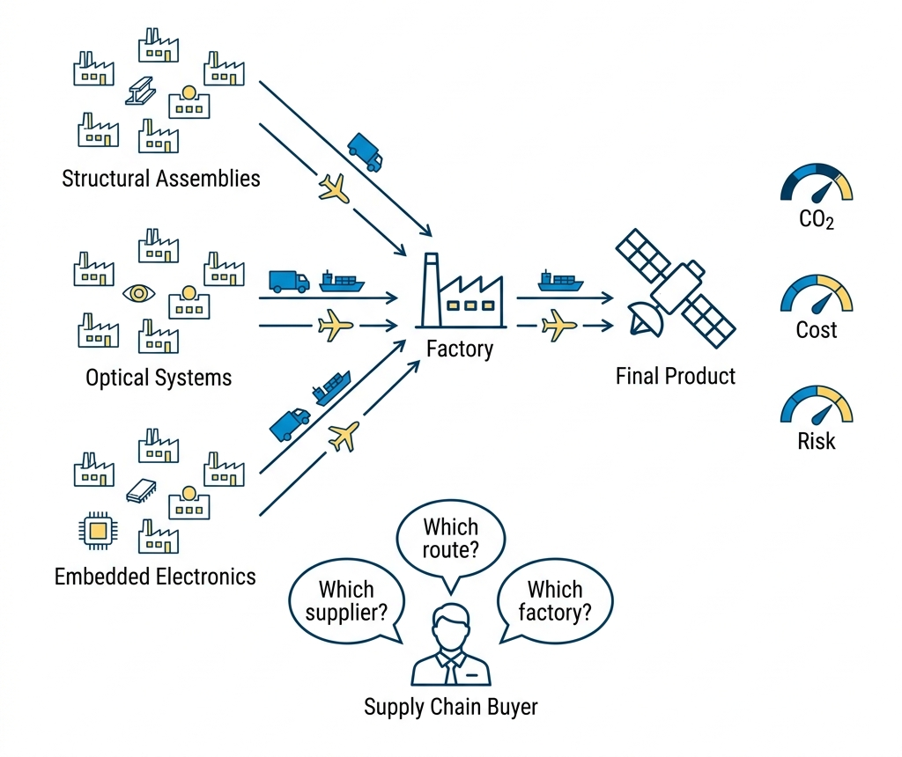




THE COMPANY AND THE PROGRAMME
ALTEN · Direction de l’Innovation · Toulouse Lab
1988
+30
11
31 %
FOUNDED
COUNTRIES
ALTEN LABS
R&D ON ENVIRONMENT
SMART GREEN SUPPLY CHAIN: THREE AIMS AT ONCE
LEAN
Cost, delay, excess stock
GREEN
Carbon per transport leg, to GLEC v3.2 and ISO 14083
PREDICTIVE
Anticipation of disruption. This work sits here.
DISCO is a serious game and digital twin covering 22 component suppliers. Routing, risk scoring, carbon and transport were all built by earlier internships. None computes urgency.
Players hold one node each, scored on cost, delay and carbon.
3 | 20

Slide 4





THE PROBLEM, STATED
THE TWIN HAS
THE TWIN NEVER SEES
Computed physical state
The human who decides
RESEARCH QUESTION
Can the gap between declared and computed urgency be measured reliably enough, inside a working digital twin, to be acted upon?
It must say which node is mismanaged
The adequacy score must be reliable and explainable.
Must beat the raw indicators a coordinator already has
4 | 20

Slide 5







THE LITERATURE GAP
What is new ?
PUBLISHED RESEARCH
THE PATENT RECORD: THREE LINES
Deadline-driven value. Time-varying, but one task only.
IBM. Revenue at risk from measured inputs. No operator opinion anywhere in the claims.
Ripple effect. Propagates, but takes the node score as given.
Wipro. Inputs replaced by language. The human narrates; nothing evaluates the narration.
Rupture indicators. Monitored one at a time, never combined.
Digital twin control tower. Oriented to automation. The operator receives decisions.
Cognitive bias. Quantified in the lab, no operational correction.
AHP, BWM, PROMETHEE. Static, and never compared to a computed value.
Fifteen years running away from the human declarant.
Digital twins. Scored on state; their inputs are assumed to arrive.
THE GAP
No system, published or patented, combines a declared urgency, a computed one and their propagated mismatch, then scores the result against recorded outcomes.
5 | 20

Slide 6
OBJECTIVES AND INDICATORS
OBJECTIVE
INDICATOR
DELIVERABLE
O1
Define real urgency and an adequacy score
Every term decomposable; aggregation justified
Specification
O2
Deliver a working, auditable application
Multi-tenant · every write audited · tests passing
SupplyScore
O3
Propagate across tiers, rank by criticality
Real-programme scale, interactive time budget
Propagation services
O4
Establish whether the signal predicts outcomes
A stated outcome definition, and a trivial baseline
Pre-registered protocol
O5
Capitalise the research for the programme
Every number reproducible from raw artefacts
BST · scripts
O6
Observe warehouse capacity instead of asking
A physical result, scored on the operational quantity
Segmentation model
6 | 20

Slide 7




THE WEEK
V-cycle for the model · Agile and Test and Learn for the week
MON
TUE
WED
THU
FRI
Planning
Scrum
Programme director
Scrum
Demonstration
The week’s objective
Blockages surface in a day
Scientific decisions
Course correction
Shown
TEST AND LEARN MEANS SOMETHING ONLY IF THINGS WERE ABANDONED
The first urgency model, and why it could not fit
A single time-driven curve: urgency rose only as a deadline approached
It could not represent a node on time but out of capacity
It discarded indicators the twin already held
Dropped in April for multi-block aggregation. Cost: three weeks
7 | 20

Slide 8
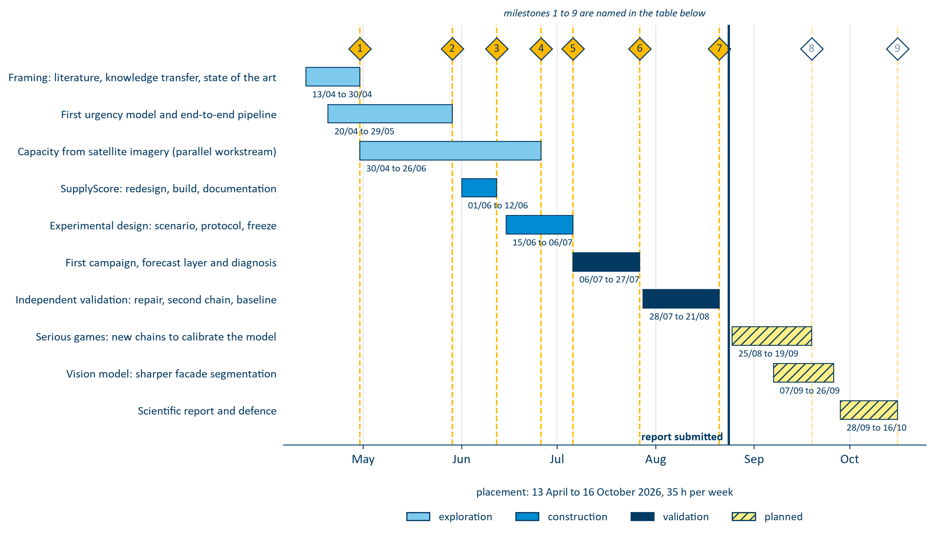
PHASES AND MILESTONES
10 phases · 9 milestones
8 | 20

Slide 9

THE MISSION
A working application, two independently elicited signals, and the score that compares them
DECLARED U_{D}
COMPUTED U_{R}
AHP, FUZZY BWM AND PROMETHEE II
WEIGHTED PROBABILISTIC OR
Operational impact
↔
Performance and capacity
Time window
↔
Time, against the next deadline
Downstream dependencies
↔
Severity propagated across tiers
Recoverability
↔
Risk, through its recovery term
No declared counterpart
↔
Cost and carbon, arbitration only
ADEQUACY SCORE
The distance between the two signals, on a 0–100 scale.
False urgency · declared > state · penalty ×1
Hidden risk · state > declared · penalty ×2
Every term stays recoverable, so the operator sees what moved the answer.
9 | 20

Slide 10



REAL URGENCY
Non-compensatory aggregation score
A node is in trouble if any one block fires. A healthy block cannot offset a failed one.
U_{r} = 1 − ∏_{m} (1 − u_{m})^{ω}_{m}
NODE A
NODE B
one block has failed
nothing has failed
The average sends the coordinator to Node B , where nothing broke. The OR sends them to Node A , where capacity did. Same six numbers, opposite ranking.
time
0.05
time
0.20
capacity
0.90
capacity
0.20
performance
0.05
performance
0.20
risk
0.05
risk
0.20
cost
0.05
cost
0.20
carbon
0.05
carbon
0.20
FOUR CAUSES · TWO CONSTRAINTS
average
0.19 → 2nd
average
0.20 → 1st
probabilistic OR
0.92 → 1st
probabilistic OR
0.74 → 2nd
Time
Capacity
Performance
ω = 0 means “nothing is known”, kept distinct from u = 0, “the block is healthy”.
Risk
Cost
Carbon
10 | 20

Slide 11
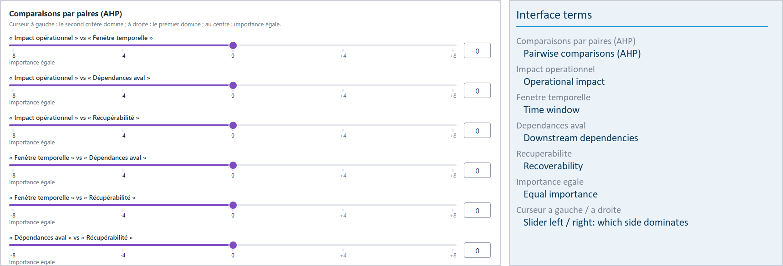
DECLARED URGENCY
Elicited from the operator, gated on consistency, then propagated downstream
THE CONSISTENCY GATE
A weight vector whose consistency ratio exceeds the threshold is refused . The operator is sent back to the most contradictory of their own comparisons.
Without it, an incoherent judgment would propagate as though it were a considered one.
The application is operated by a French research programme, so its interface is French.
FOUR CRITERIA, EACH WITH A COMPUTED COUNTERPART
Pairwise comparisons, not a free-text estimate
Operational impact
Time window
AHP · fuzzy BWM · PROMETHEE II
Downstream dependencies
Recoverability
Descends from the customer towards suppliers, attenuated
γ
11 | 20

Slide 12
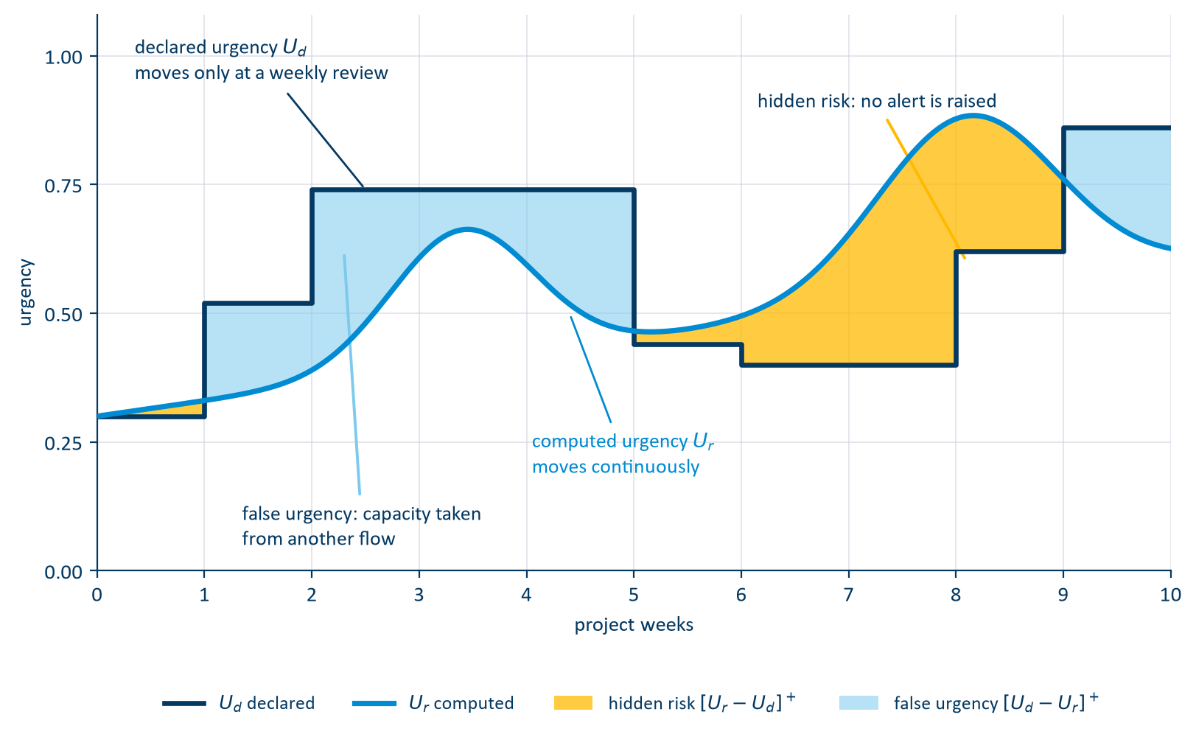
THE ADEQUACY
Elicited separately, propagated in opposite directions
PROPAGATION ACROSS THE NETWORK
γ
Customer · final assembly
Tier 1 · systems
Tier 2 · subassemblies
Tier 3 · raw material
β
γ attenuates the declaration as it descends: demand pressure is what a customer transmits
β amplifies computed risk as it ascends: physical risk is what a supplier transmits
12 | 20

Slide 13
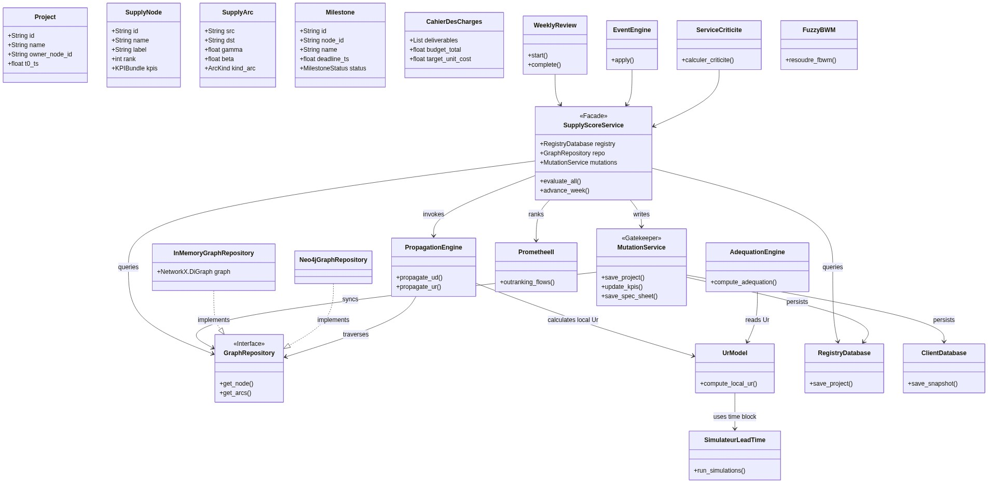
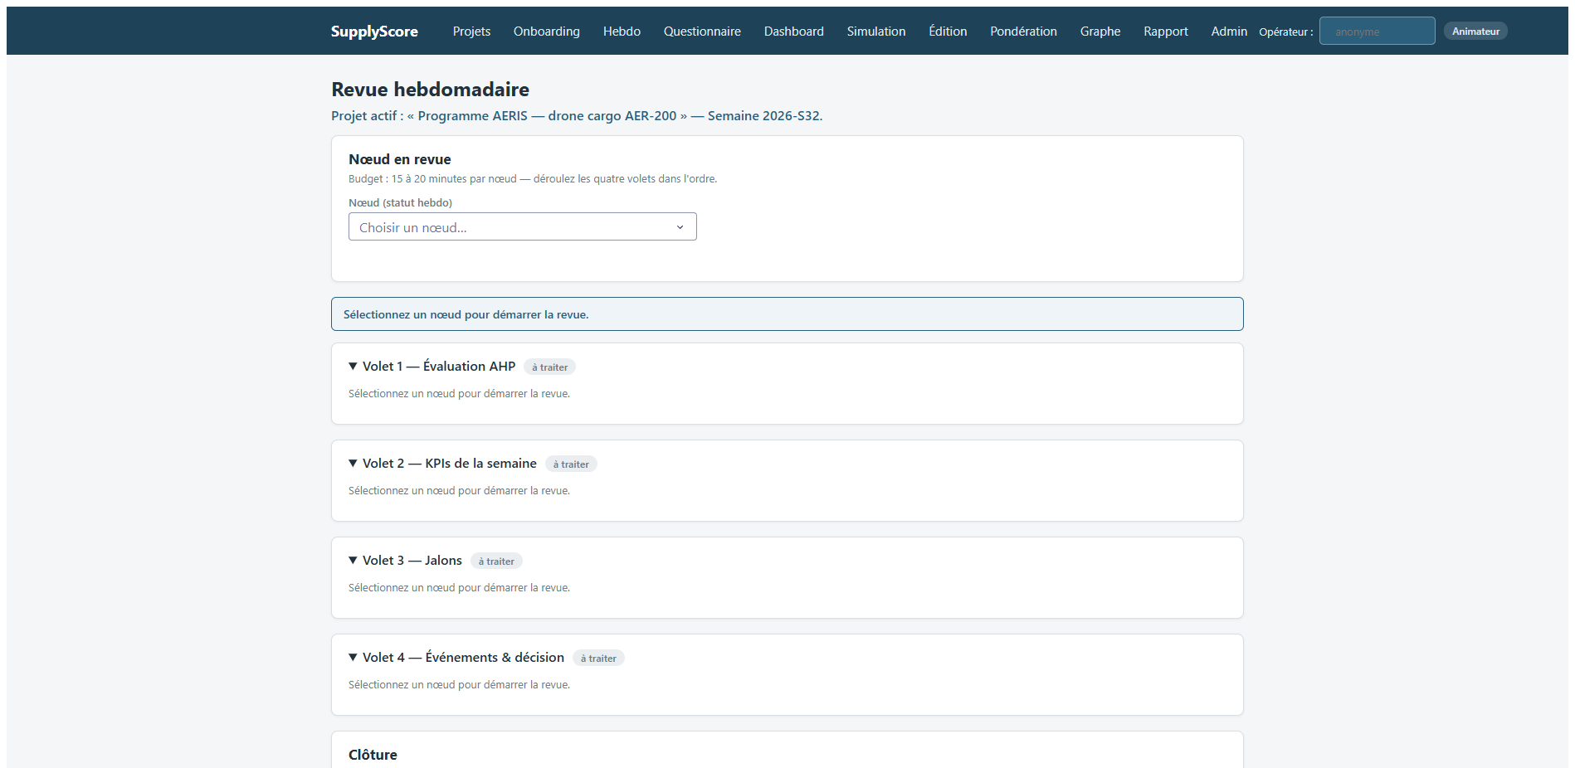
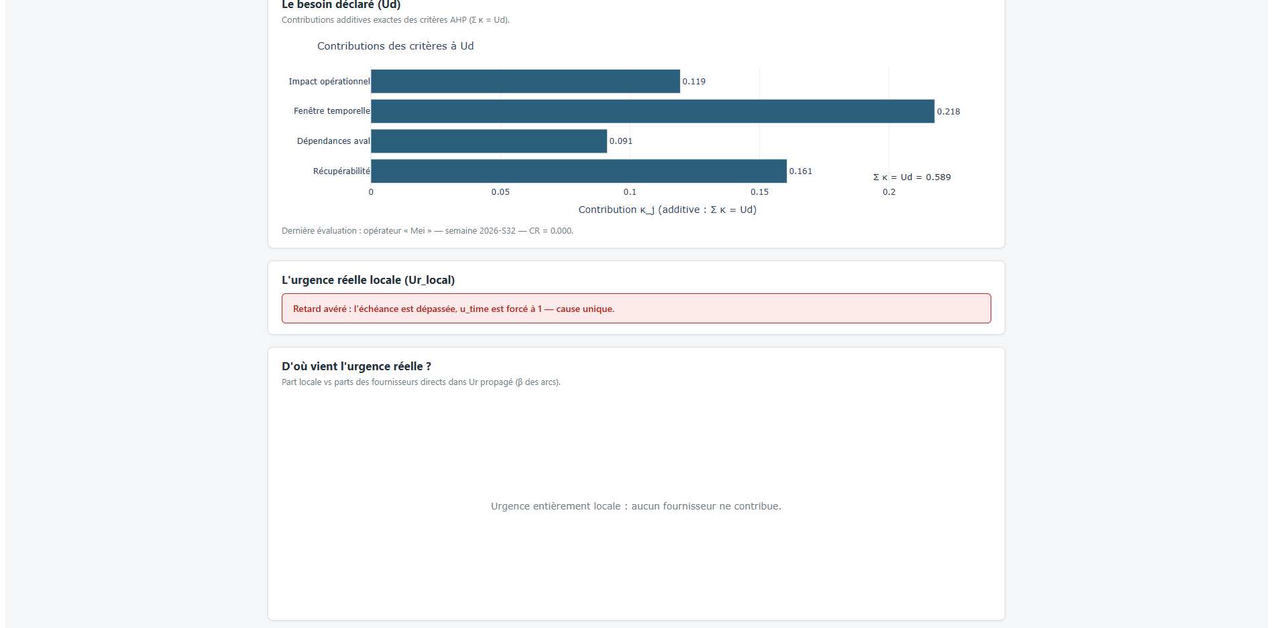
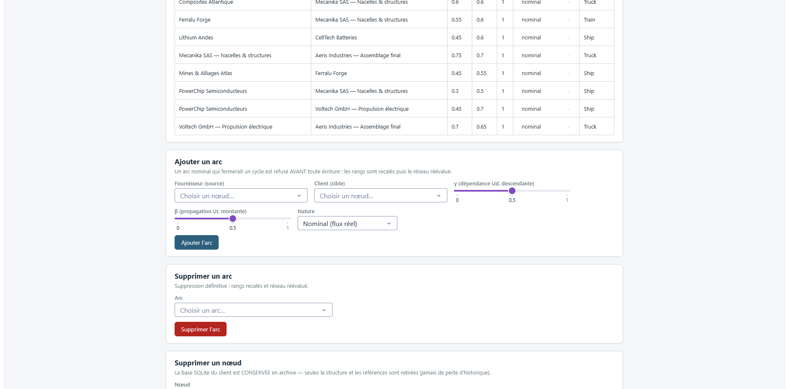
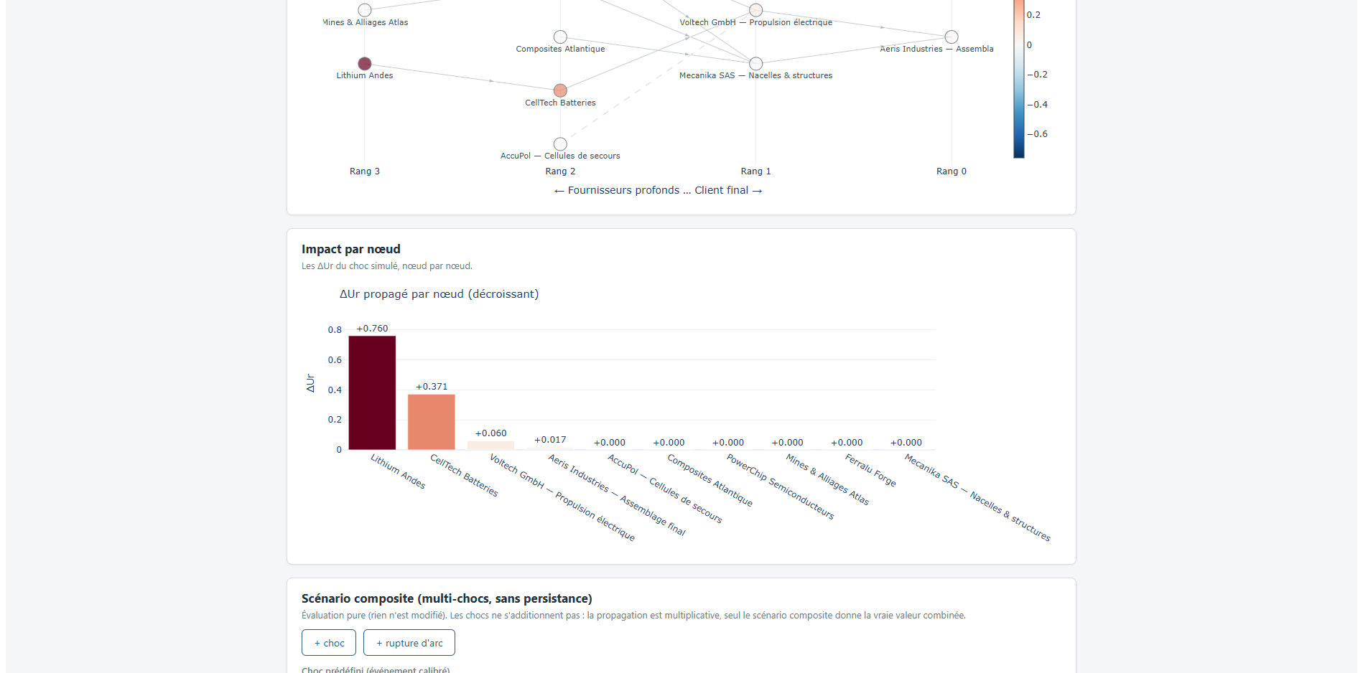
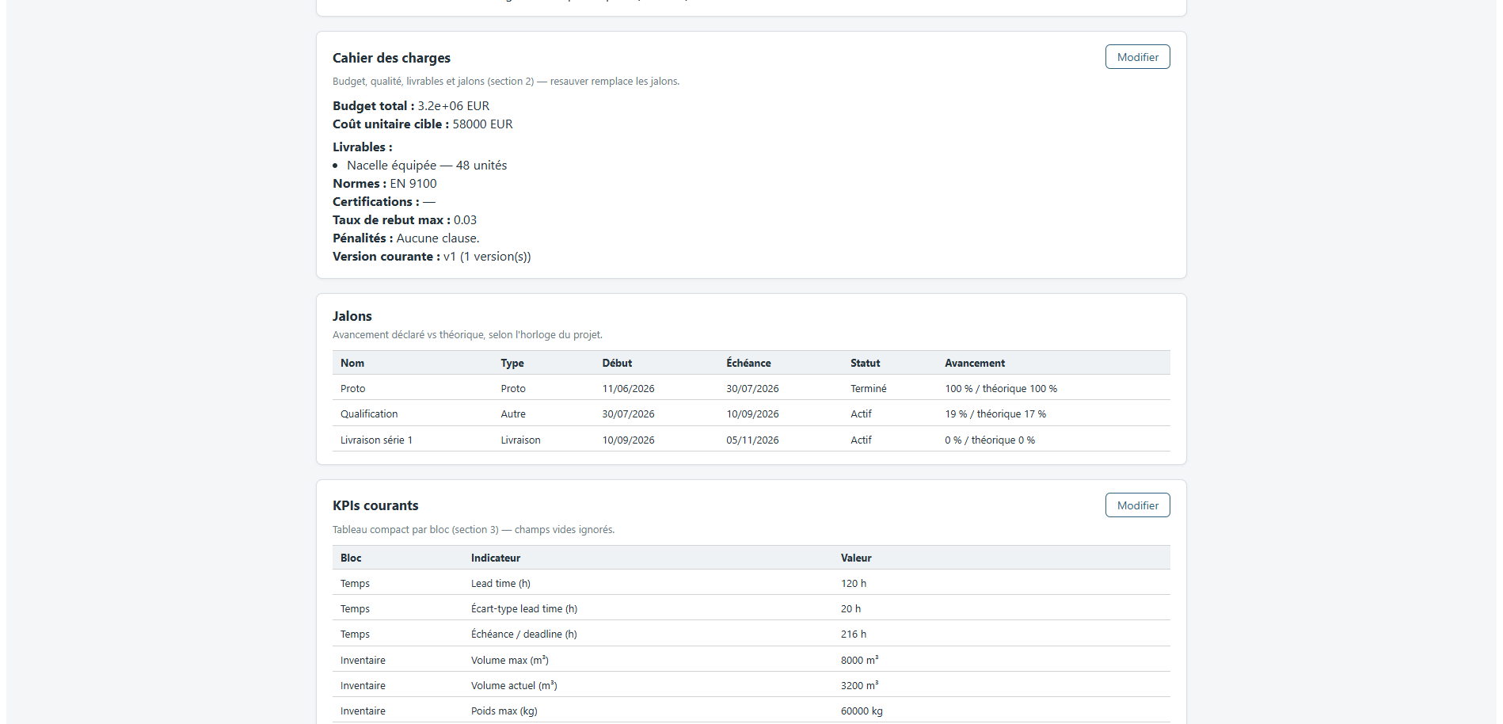

SUPPLYSCORE: ARCHITECTURE
The class model, and the pages it drives
THE CLASS MODEL
THE APPLICATION, AS THE OPERATOR MEETS IT
Weekly review · one signed transaction
Explainability · term by term
Network · generated per project
Criticality · each node knocked out
A NODE, AND WHAT IT CARRIES
Facade the only entry point
Mutation service the audit trail is architectural
One DB per node isolation by storage layout
Every arrow into the data crosses the facade, then the mutation service. Two graph repositories sit behind one interface, so the network can be held in memory or in Neo4j without the domain knowing which.
13 | 20

Slide 14

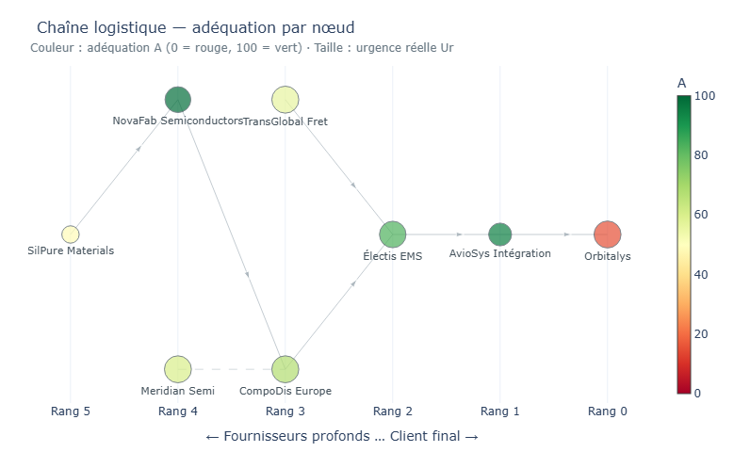
RESULT 1: EARLY WARNING
Nodes ranked by hidden risk above 0.10, against the nodes that later missed
1.00
3 / 4
0
8
PRECISION, TURNS 0–5
FUTURE FAILURES FLAGGED
FALSE ALARMS IN SIX TURNS
TURNS OF ADVANCE WARNING
T0 – T5 · signal sharp
T6 – T18 · crisis public, the gap closes
Precision 1.00 · recall 0.75 · 0 false alarms
The worst-scoring node is the satellite prime. Flagged from turn 0, it misses at turn 8: eight turns of warning, while its own manager declares an urgency of 0.001.
THE DASHBOARD THE COORDINATOR READS
The flag comes from an optimistic declaration against a computed state that is not . From turn 6 precision falls to 0.50 or below: the crisis becomes public, everyone raises their declaration, and a difference closes mechanically.
Early warning, not crisis management. Encouraging on eight nodes, not a rate.
14 | 20

Slide 15
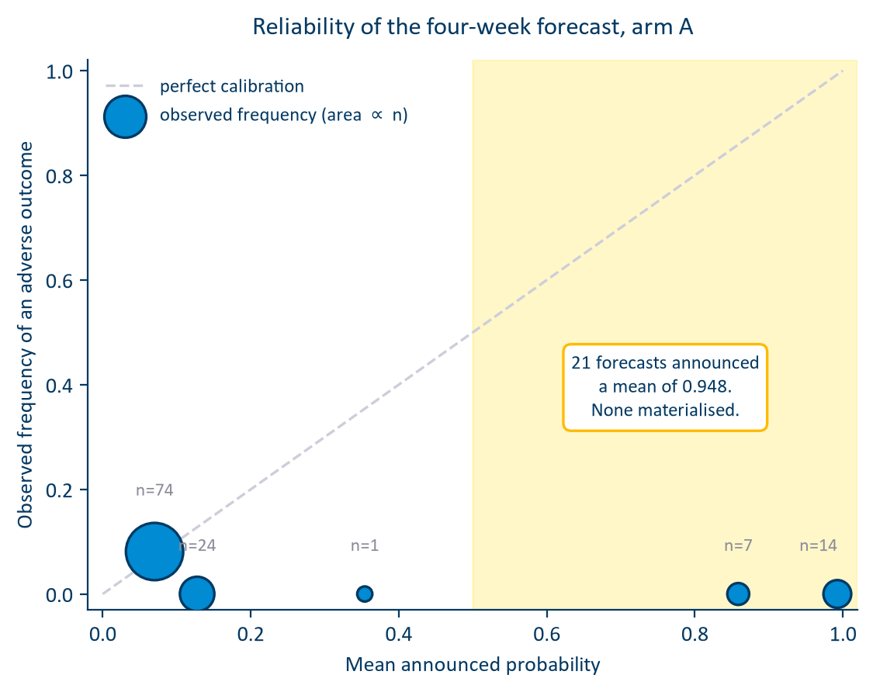



RESULT 2: ONE BLOCK EXPLAINED IT
Scored → diagnosed → repaired → re-measured, on the same 120 frozen forecasts
BRIER SKILL, BEFORE → AFTER
HORIZON
before
structure
+ uncert.
1 week
−1.278
−0.646
−0.687
2 weeks
−0.690
−0.401
−0.367
3 weeks
−0.654
−0.360
−0.286
4 weeks
−0.553
−0.272
−0.216
The calibration deficit roughly halved at every horizon. AUC movement is not interpretable at this sample size : with twenty-six positives the four-week interval runs from 0.21 to 0.87.
Progress now drawn per replicate, widened by each node’s own hidden risk, so the tool calibrates itself
Diagnosed: events never write to the time axis. Across 328 indicator snapshots the accumulated-delay field was written zero times
Indicator coverage rose 25.6 % → 49.1 %. An empty database hides the model’s errors
Repaired: lost time is additive. completion = t + (1 − progress) × lead + lost time
Still negative at every horizon. Reported as such.
15 | 20

Slide 16

RESULT 3: THE DOMAIN ESTABLISHED
A second chain, and the cheapest thing that could replace the forecast layer
WHICH RANKING FINDS THE THREE FAILING SUPPLIERS?
500 MONTE CARLO TRAJECTORIES VS. A TWO-NUMBER RATIO
Adequacy score
0.00
Hidden risk
0.00
6 / 8
−1.60
Forecast probability
0.56
horizons where the baseline ranks better , by 0.082 of AUC at one week
simulation Brier skill vs. −4.85 for the baseline. The trajectories buy calibration
The three suppliers that miss declare the
1st, 2nd and 4th highest
urgencies from the opening turn. At turn 0 they declare 0.982, 0.941 and 0.876 against computed states of 0.655, 0.838 and 0.542. Hidden risk is computed minus declared, clipped at zero, so nothing selects them against a base rate of 0.20. Their free text says they meant to wait for a recovery plan.
client-impact channel displayed, never scored
six urgency blocks
AR(1) state
lead-time draw
milestone term
the quantity that is scored
THE MISPERCEPTION BOUNDARY
The tool measures misperception, not non-disclosure . Precision 1.00 on chain 1 and 0.00 on chain 2 do not contradict: they name the domain.
On this chain the forecast layer is a calibration wrapper around a lead-time ratio . Defensible, but not what the interface presents. The fix is one line: the AR state must reach the milestone term.
16 | 20

Slide 17
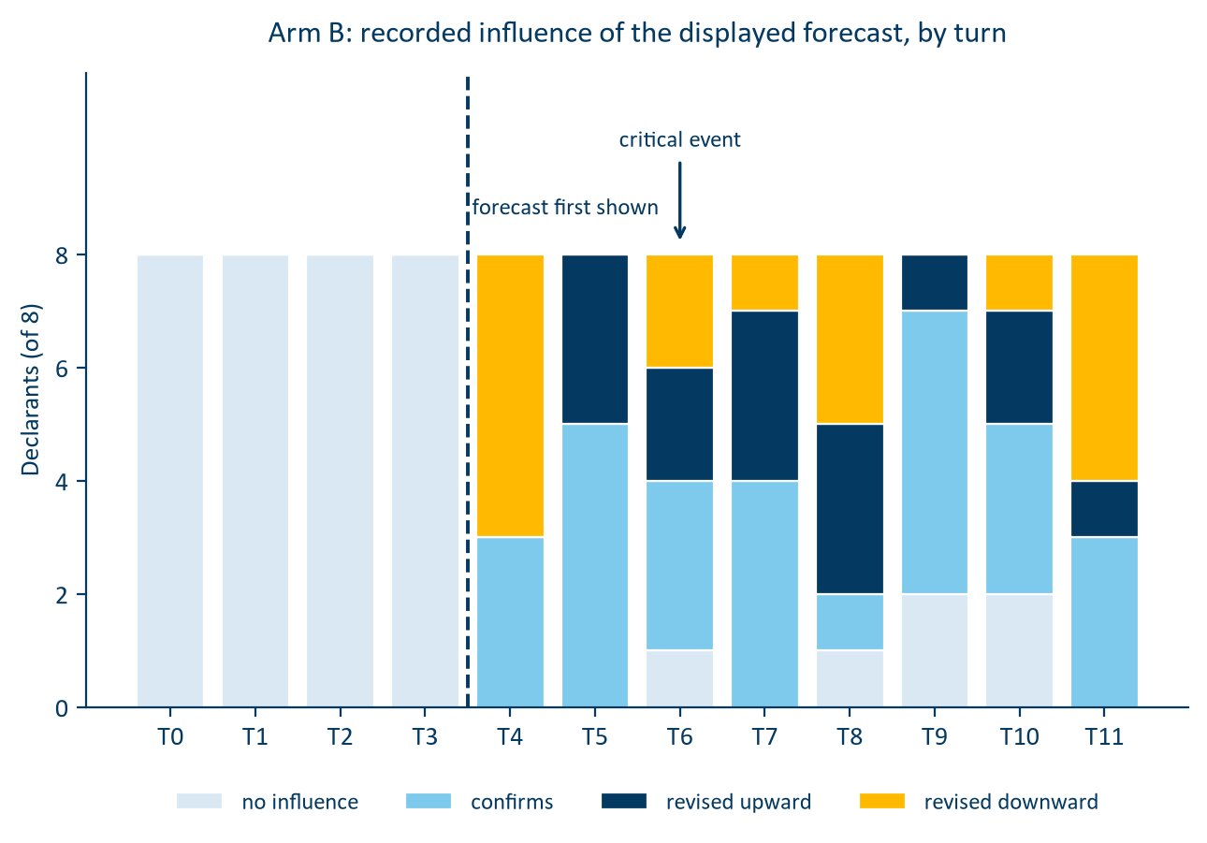
THE RESULT NOBODY PLANNED
Showing the forecast before asking for a declaration changes the declaration
5 down · 3 confirmed · 0 up
At first contact all eight declarants record an influence and not one revises upward . Reproduced exactly in the repaired run.
15 up · 16 down
Over the full campaign the balance is even. The one-sided effect belongs to first contact , shown as a probability with a confidence interval.
1 in 10 · max 0.93
On the second chain, turn-to-turn jumps above 0.20 on unchanged terrain. Disengagement is the rational response, not negligence.
17 | 20

Slide 18


OBJECTIVES VS. OUTCOMES
2 campaigns · 2 chains · 23 nodes · 33 milestones · 510 declarations
O1
Met
Six blocks, bidirectional propagation, asymmetric score — every term decomposable
O2
Met
SupplyScore delivered: multi-tenant, every write audited, tested, documented
O3
Met
Propagation and criticality operational; the saturation collapse found and repaired
O4
Met, domain established
Right at node level on chain 1; scored, located, repaired, re-measured; then bounded by chain 2 and the baseline
O5
Met
Every reported figure regenerated from raw artefacts by script, not transcribed
O6
Met, reframed
Docks cannot be counted from nadir, established by measurement. Segmentation reaches −35 % bias
WHAT THE PROGRAMME CAN NOW SAY ABOUT SUPPLYSCORE
Detects misperception, not non-disclosure
An early-warning tool that closes once a crisis is public
Its forecast buys calibration , not short-horizon discrimination
18 | 20

Slide 19

LIMITS · NEXT · WHAT I TAKE
Three limits of sample, one of method, and a list produced by measurement
LIMITS
FOR ALTEN, IN ORDER
THE LESSON I KEEP
Agents, not human consultants
1
Connect computed urgency to the forecast quantity. One afternoon of work.
An early dry run derived the declared value from the computed one, and had to be discarded.
Small positive class: 4 of 8, 3 of 15
I would now design the independence of two signals before designing either.
2
Fill the indicators before calibrating anything
Carbon block least exercised, for want of node-level data
And: before trusting a component, write the cheapest thing that could replace it.
3
Make the forecast state its own ignorance; smooth the alarm
Methodological, and it does not dissolve with data: no number holds without its outcome definition
ESTIA COMPETENCY FRAMEWORK
4
Run the campaign with humans, the only run that decides
CI1
CI3
CI5
CE3
CE4
CE5
CST1
CST2
CST7
The difficulty was never the mathematics. It sits at the two joins: model to world, and output to the person who acts on it.
19 | 20

Slide 20


THANK YOU
QUESTIONS
HOARAU John · Promotion 2026 ALTEN Sud-Ouest · Direction de l’Innovation · Lab de Toulouse 13 April → 16 October 2026
20 | 20

